Slide 1
Chapter 10 - C Structures, Unions, Bit Manipulations, and Enumerations
Outline
10.1 Introduction
10.2 Structure Definitions
10.3 Initializing Structures
10.4 Accessing Members of Structures
10.5 Using Structures with Functions
10.6 typedef
10.7 Example: High-Performance Card Shuffling and Dealing Simulation
10.8 Unions
10.9 Bitwise Operators
10.10 Bit Fields
10.11 Enumeration Constants

Slide 2
Objectives
In this tutorial, you will learn:
  To be able to create and use structures, unions and enumerations.
  To be able to pass structures to functions call by value and call by reference.
  To be able to manipulate data with the bitwise operators.
  To be able to create bit fields for storing data compactly.

Slide 3
10.1 Introduction
Structures
  Collections of related variables (aggregates) under one name
    Can contain variables of different data types
  Commonly used to define records to be stored in files
  Combined with pointers, can create linked lists, stacks, queues, and trees

Slide 4
10.2 Structure Definitions
Example
      struct card {
      char *face;
      char *suit;
      };
  struct introduces the definition for structure card
  card is the structure name and is used to declare variables of the structure type
  card contains two members of type char *
    These members are face and suit

Slide 5
10.2 Structure Definitions
struct information
  A struct cannot contain an instance of itself
  Can contain a member that is a pointer to the same structure type
  A structure definition does not reserve space in memory
    Instead creates a new data type used to define structure variables
Definitions
  Defined like other variables:
      card oneCard, deck[ 52 ], *cPtr;
  Can use a comma separated list:
      struct card {
      char *face;
      char *suit;
      } oneCard, deck[ 52 ], *cPtr;

Slide 6
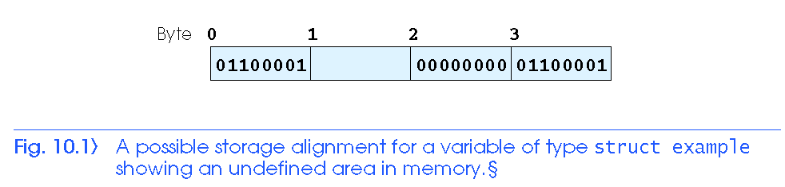
10.2 Structure Definitions

Slide 7
10.2 Structure Definitions
Valid Operations
  Assigning a structure to a structure of the same type
  Taking the address (&) of a structure
  Accessing the members of a structure
  Using the sizeof operator to determine the size of a structure

Slide 8
10.3 Initializing Structures
Initializer lists
  Example:
    card oneCard = { "Three", "Hearts" };
Assignment statements
  Example:
    card threeHearts = oneCard;
  Could also define and initialize threeHearts as follows:
    card threeHearts;
    threeHearts.face = “Three”;
    threeHearts.suit = “Hearts”;

Slide 9
10.4 Accessing Members of Structures
Accessing structure members
  Dot operator (.) used with structure variables
    card myCard;
    printf( "%s", myCard.suit );
  Arrow operator (->) used with pointers to structure variables
    card *myCardPtr = &myCard;
    printf( "%s", myCardPtr->suit );
  myCardPtr->suit is equivalent to
    ( *myCardPtr ).suit

Slide 10
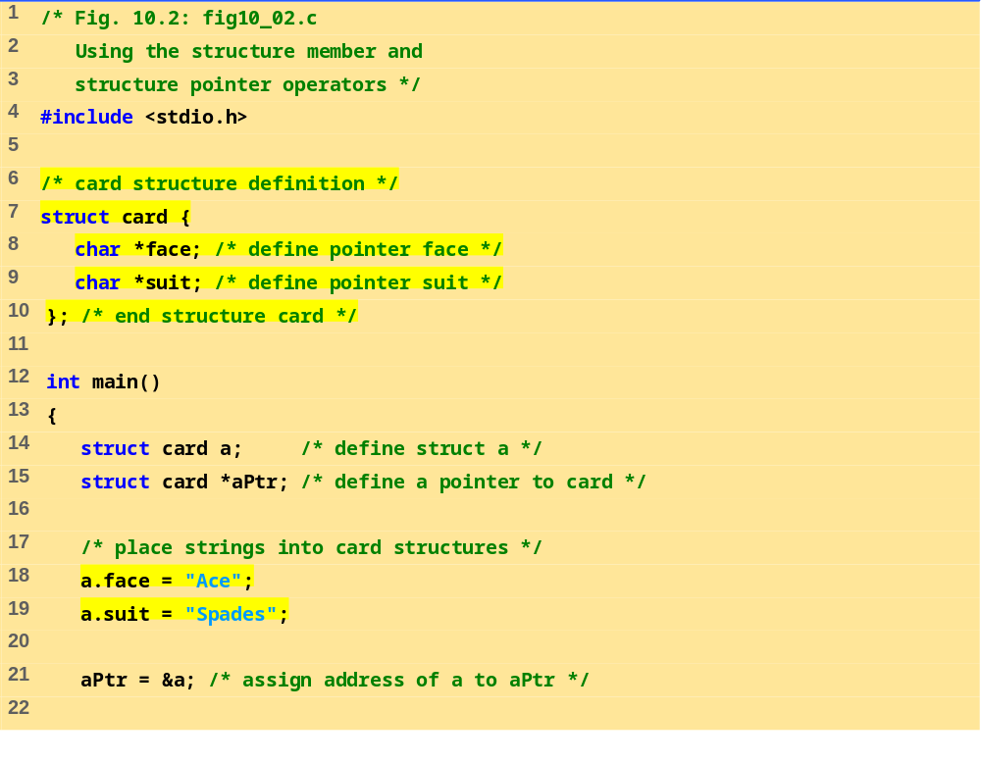
fig10_02.c (Part 1 of 2)

Slide 11
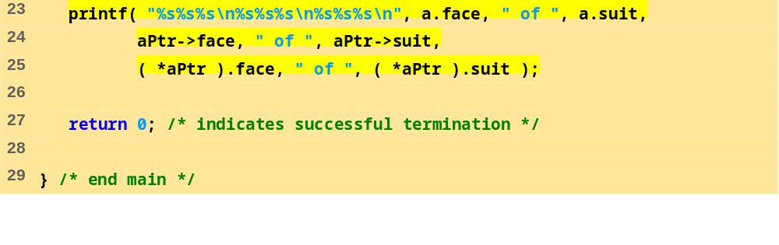
fig10_02.c (Part 2 of 2)
Program Output
Ace of Spades
Ace of Spades
Ace of Spades

Slide 12
10.5 Using Structures With Functions
Passing structures to functions
  Pass entire structure
    Or, pass individual members
  Both pass call by value
To pass structures call-by-reference
  Pass its address
  Pass reference to it
To pass arrays call-by-value
  Create a structure with the array as a member
  Pass the structure

Slide 13
10.6 typedef
typedef
  Creates synonyms (aliases) for previously defined data types
  Use typedef to create shorter type names
  Example:
      typedef struct Card *CardPtr;
  Defines a new type name CardPtr as a synonym for type struct Card *
  typedef does not create a new data type
    Only creates an alias

Slide 14
10.7 Example: High-Performance Card-shuffling and Dealing Simulation
Pseudocode:
  Create an array of card structures
  Put cards in the deck
  Shuffle the deck
  Deal the cards

Slide 15
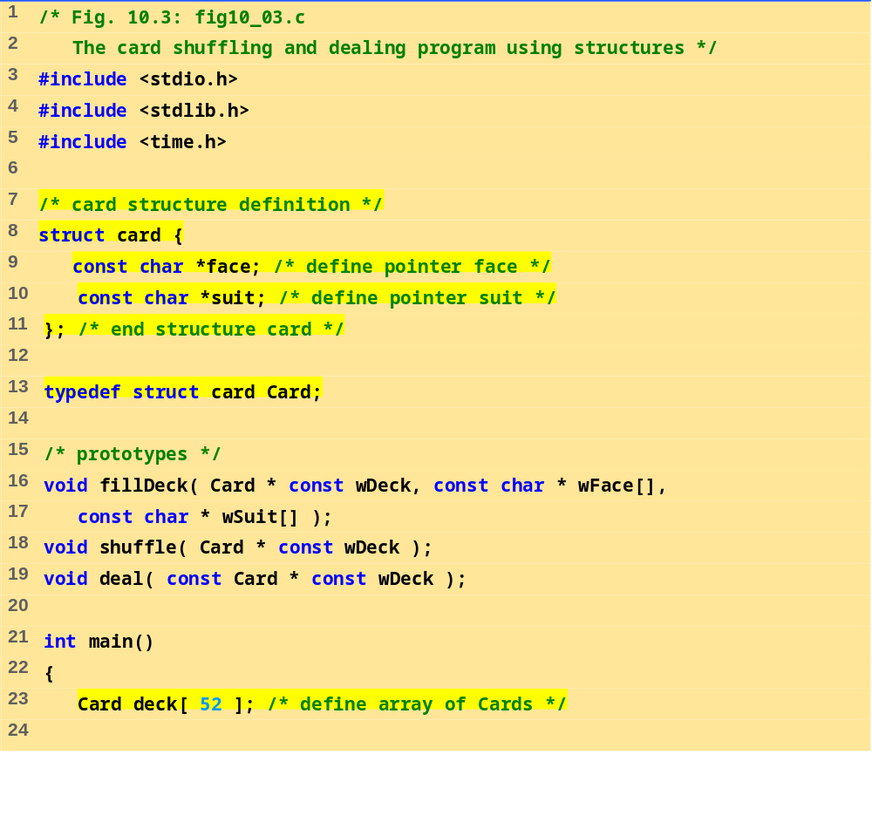
fig10_03.c (Part 1 of 4)

Slide 16
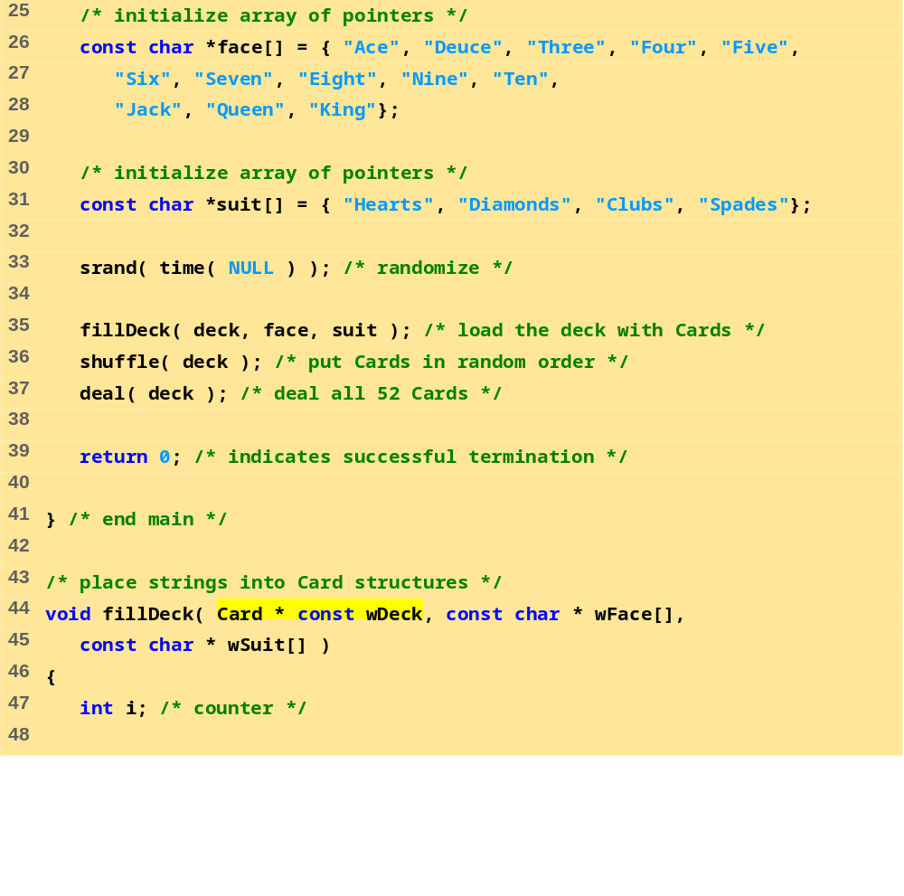
fig10_03.c (Part 2 of 4)

Slide 17
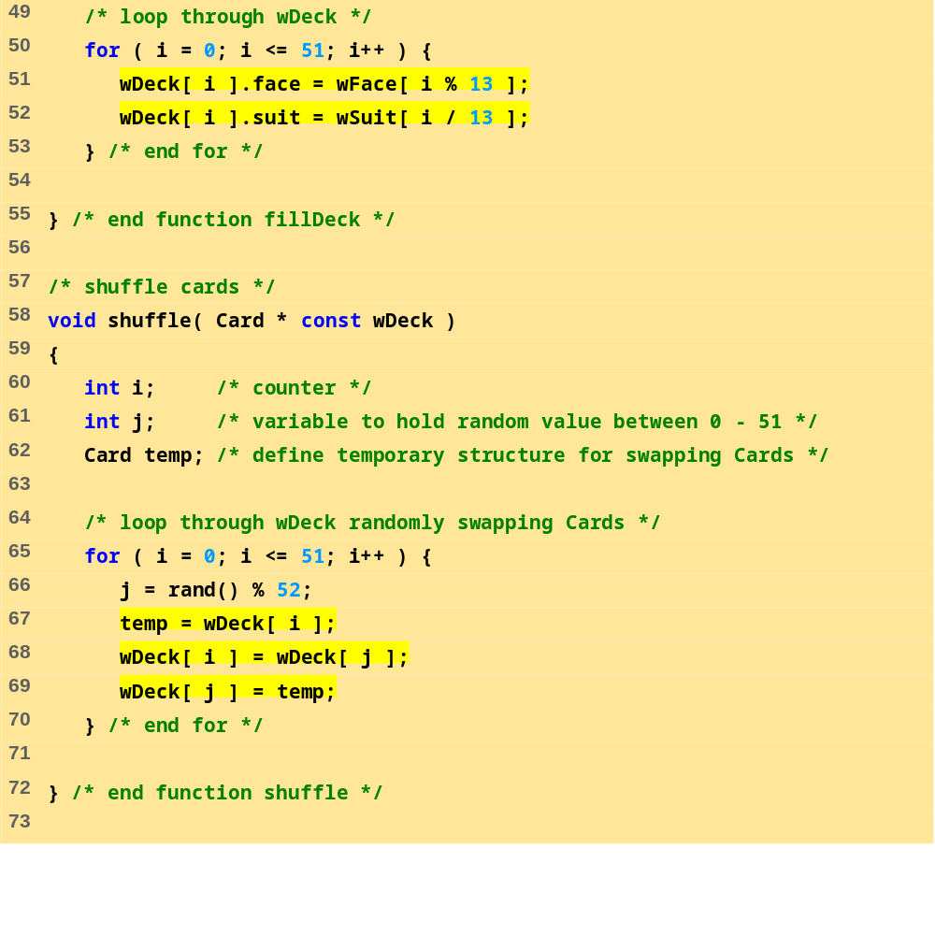
fig10_03.c (3 of 4)

Slide 18
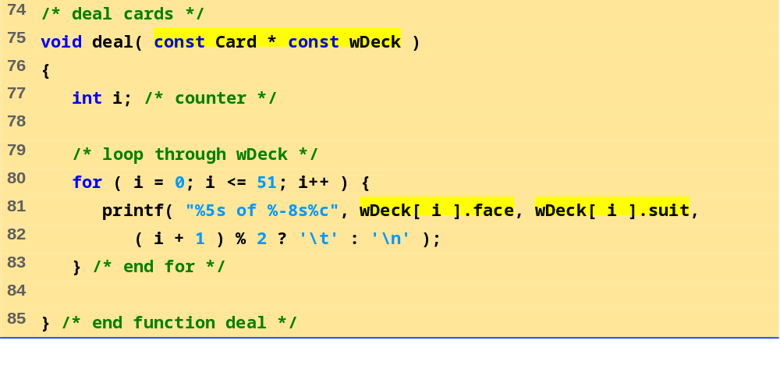
fig10_03.c (4 of 4)

Slide 19
Four of Clubs Three of Hearts
Three of Diamonds Three of Spades
Four of Diamonds Ace of Diamonds
Nine of Hearts Ten of Clubs
Three of Clubs Four of Hearts
Eight of Clubs Nine of Diamonds
Deuce of Clubs Queen of Clubs
Seven of Clubs Jack of Spades
Ace of Clubs Five of Diamonds
Ace of Spades Five of Clubs
Seven of Diamonds Six of Spades
Eight of Spades Queen of Hearts
Five of Spades Deuce of Diamonds
Queen of Spades Six of Hearts
Queen of Diamonds Seven of Hearts
Jack of Diamonds Nine of Spades
Eight of Hearts Five of Hearts
King of Spades Six of Clubs
Eight of Diamonds Ten of Spades
Ace of Hearts King of Hearts
Four of Spades Jack of Hearts
Deuce of Hearts Jack of Clubs
Deuce of Spades Ten of Diamonds
Seven of Spades Nine of Clubs
King of Clubs Six of Diamonds
Ten of Hearts King of Diamonds
Program Output

Slide 20
10.8 Unions
union
  Memory that contains a variety of objects over time
  Only contains one data member at a time
  Members of a union share space
  Conserves storage
  Only the last data member defined can be accessed
union definitions
  Same as struct
      union Number {
      int x;
      float y;
      };
      union Number value;

Slide 21
10.8 Unions
Valid union operations
  Assignment to union of same type: =
  Taking address: &
  Accessing union members: .
  Accessing members using pointers: ->

Slide 22
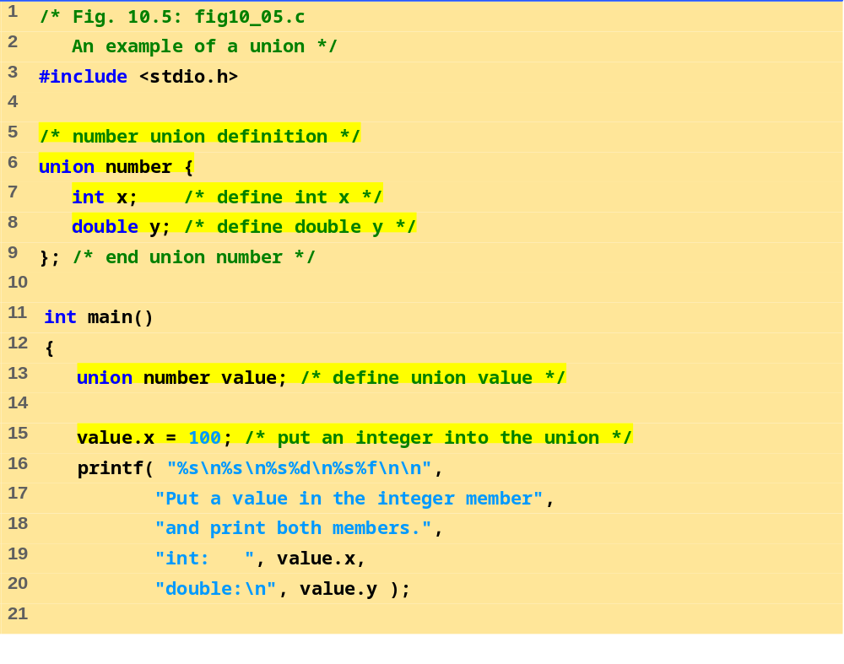
fig10_05.c (1 of 2)

Slide 23
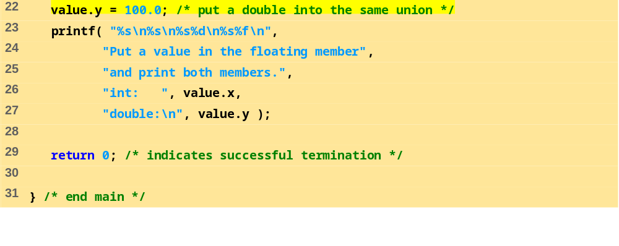
fig10_05.c (2 of 2)
Put a value in the integer member
and print both members.
int: 100
double:
-92559592117433136000000000000000000000000000000000000000000000.000000
Put a value in the floating member
and print both members.
int: 0
double:
100.000000

Slide 24
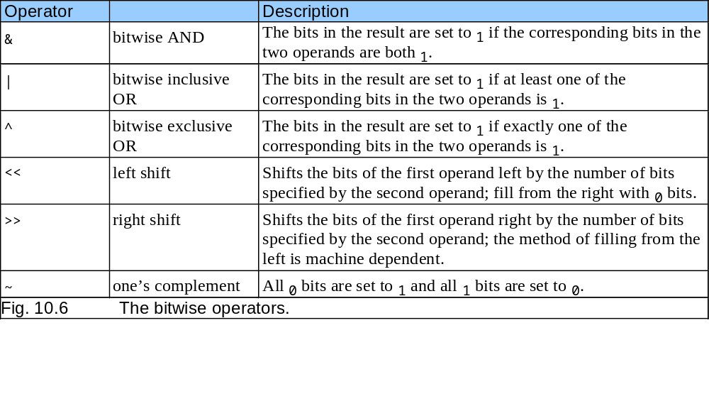
10.9 Bitwise Operators
All data represented internally as sequences of bits
  Each bit can be either 0 or 1
  Sequence of 8 bits forms a byte

Slide 25
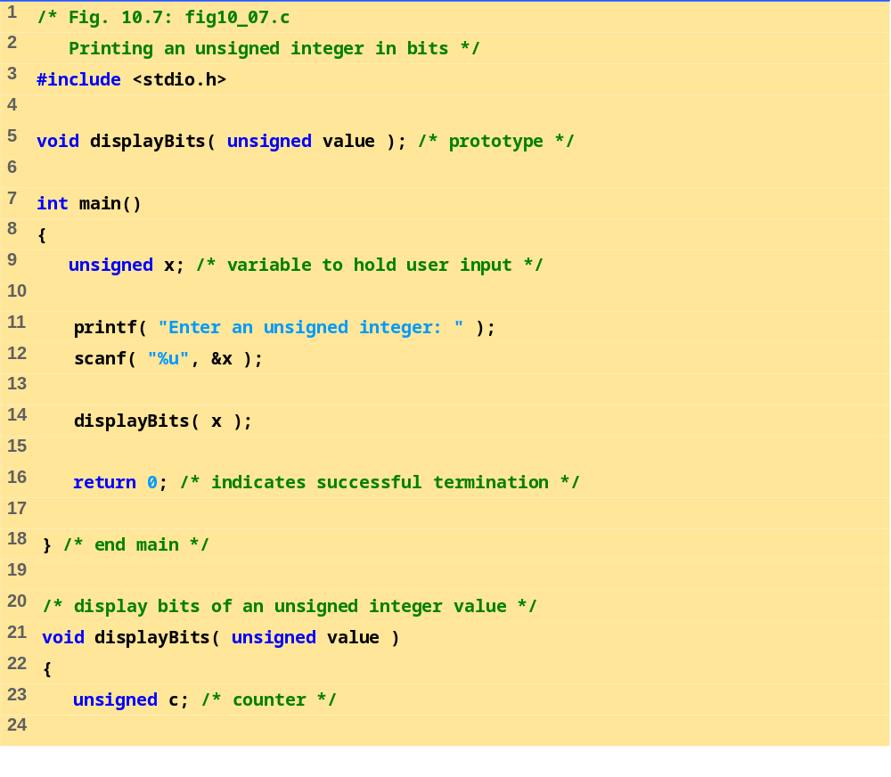
fig10_07.c (1 of 2)

Slide 26
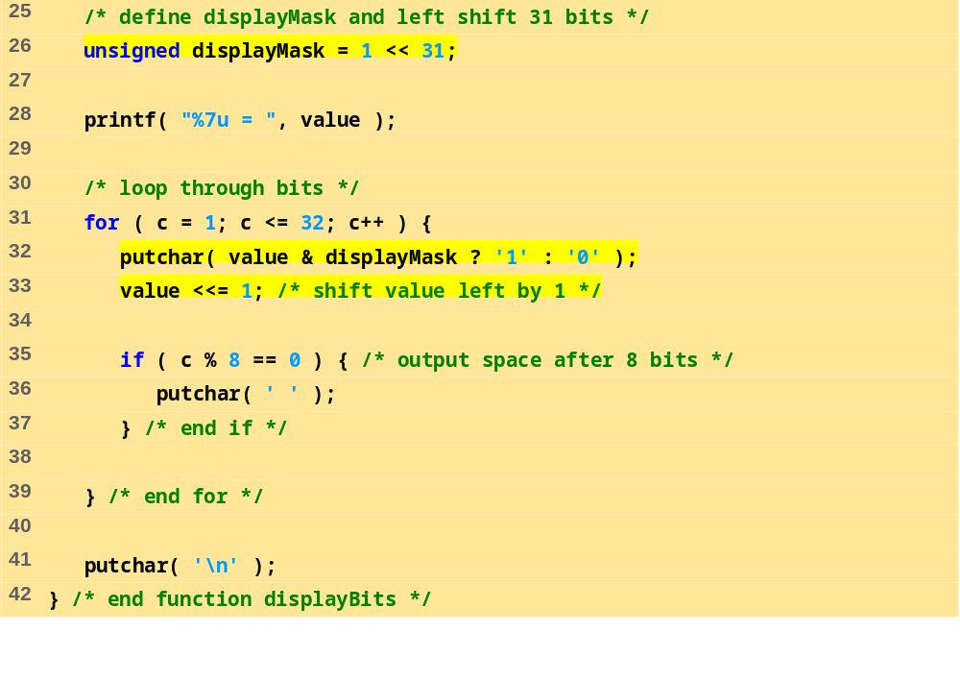
fig10_07.c (2 of 2)
Enter an unsigned integer: 65000
65000 = 00000000 00000000 11111101 11101000

Slide 27
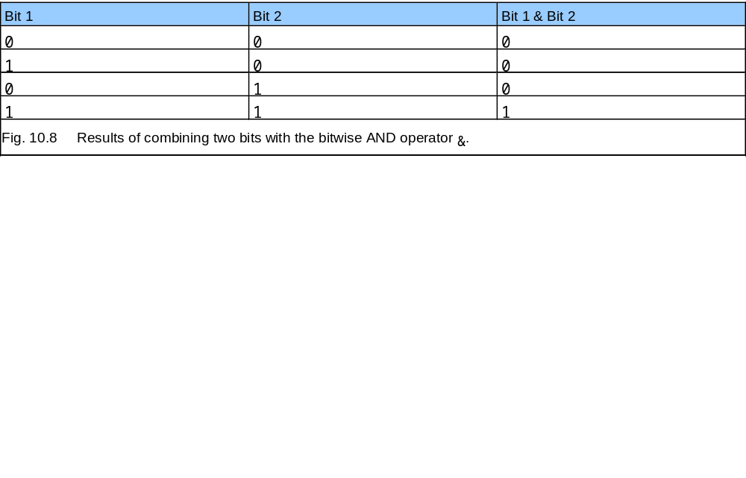
10.9 Bitwise Operators

Slide 28
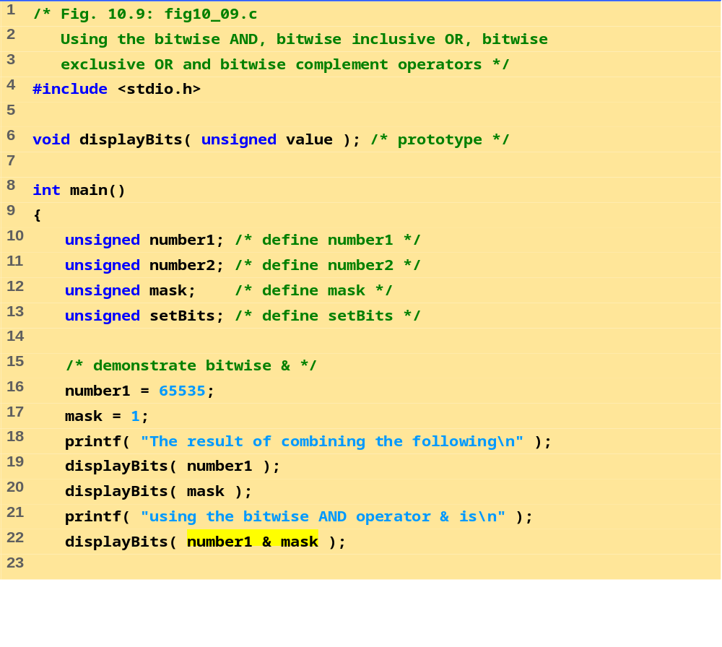
fig10_09.c (1 of 4)

Slide 29
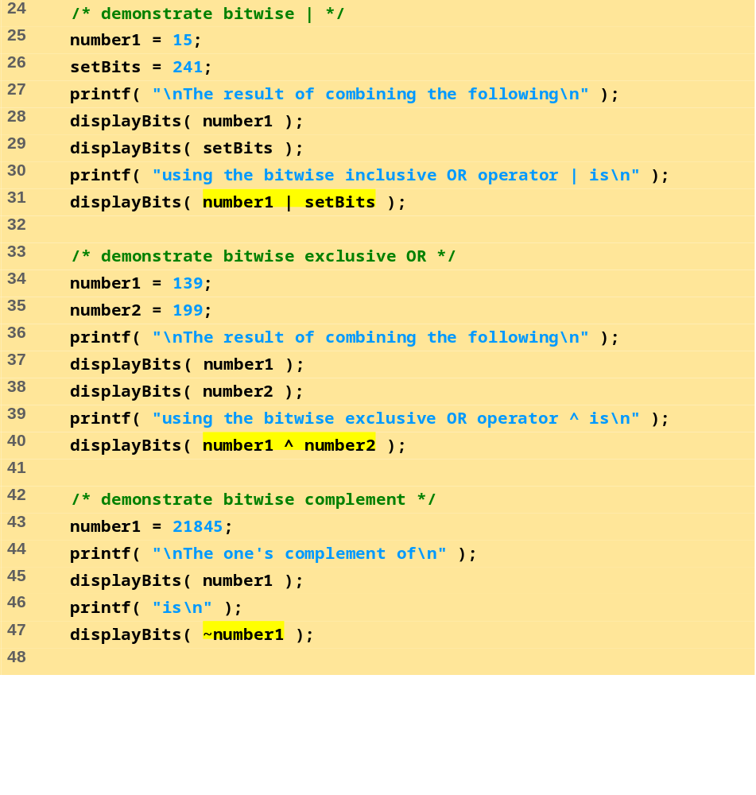
fig10_09.c (2 of 4)

Slide 30
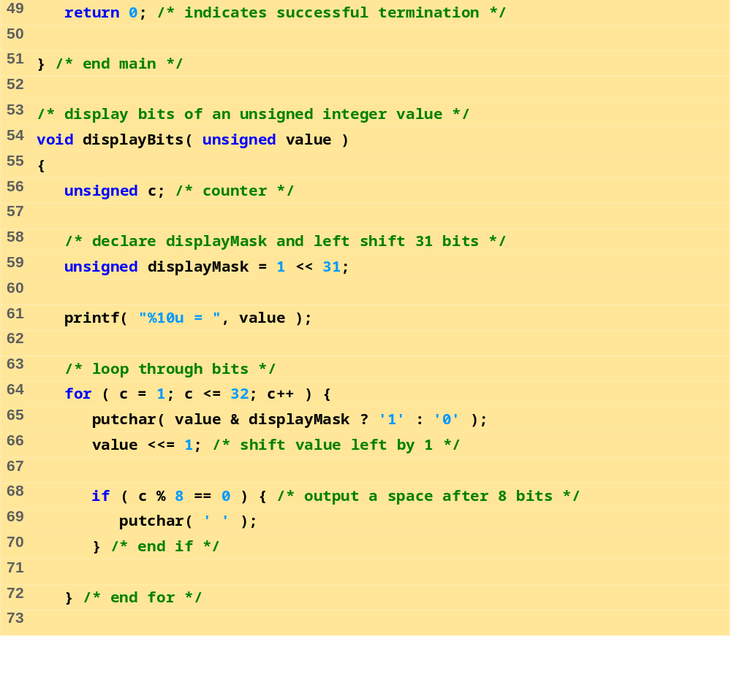
fig10_09.c (3 of 4)

Slide 31
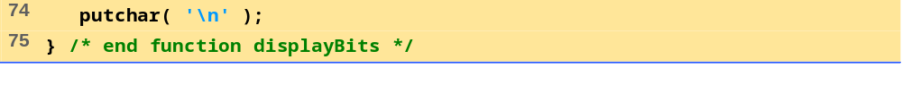
The result of combining the following
65535 = 00000000 00000000 11111111 11111111
1 = 00000000 00000000 00000000 00000001
using the bitwise AND operator & is
1 = 00000000 00000000 00000000 00000001
The result of combining the following
15 = 00000000 00000000 00000000 00001111
241 = 00000000 00000000 00000000 11110001
using the bitwise inclusive OR operator | is
255 = 00000000 00000000 00000000 11111111
The result of combining the following
139 = 00000000 00000000 00000000 10001011
199 = 00000000 00000000 00000000 11000111
using the bitwise exclusive OR operator ^ is
76 = 00000000 00000000 00000000 01001100
The one's complement of
21845 = 00000000 00000000 01010101 01010101
is
4294945450 = 11111111 11111111 10101010 10101010
fig10_09.c (4 of 4)
Program Output

Slide 32
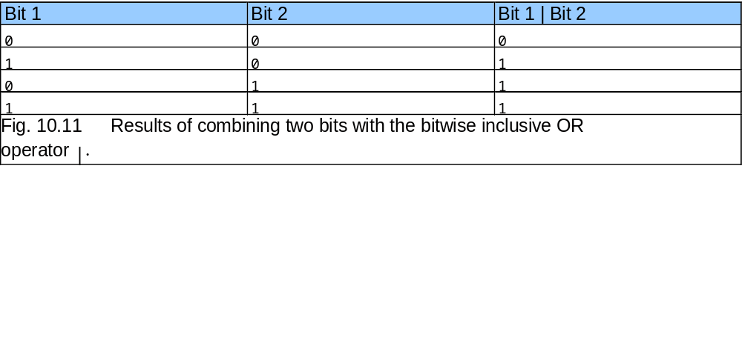
10.9 Bitwise Operators

Slide 33
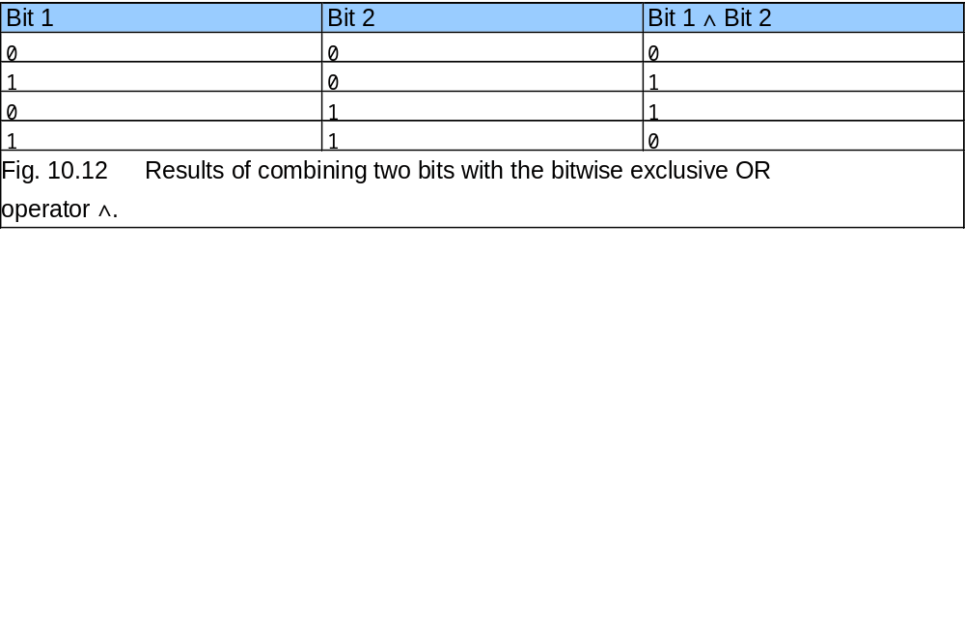
10.9 Bitwise Operators

Slide 34
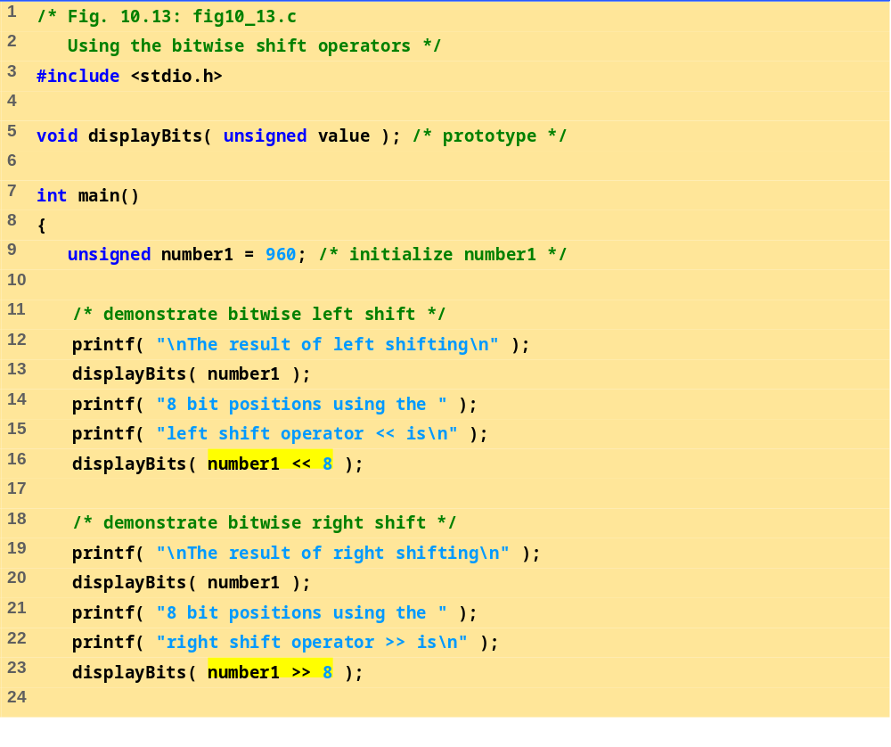
fig10_13.c (1 of 2)

Slide 35
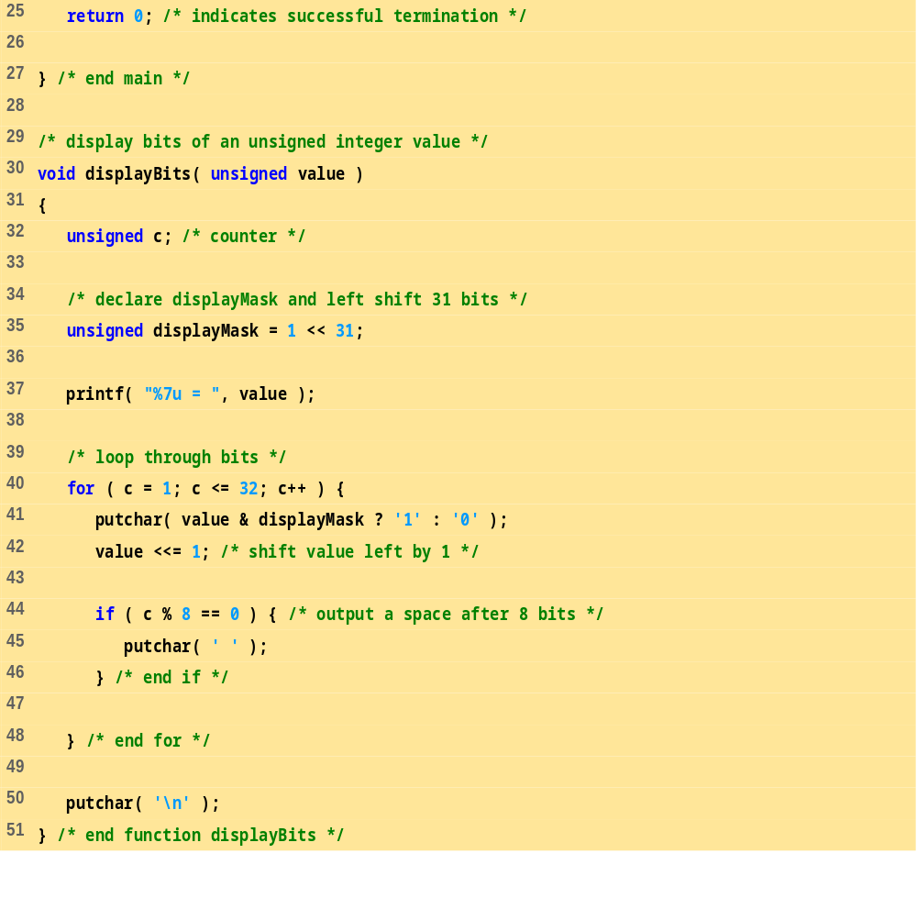
fig10_13.c (2 of 2)

Slide 36
The result of left shifting
960 = 00000000 00000000 00000011 11000000
8 bit positions using the left shift operator << is
245760 = 00000000 00000011 11000000 00000000
The result of right shifting
960 = 00000000 00000000 00000011 11000000
8 bit positions using the right shift operator >> is
3 = 00000000 00000000 00000000 00000011
Program Output

Slide 37
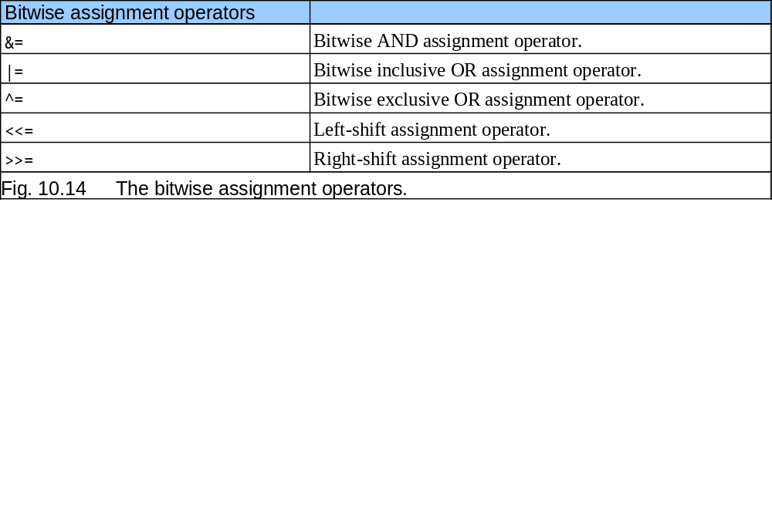
10.9 Bitwise Operators

Slide 38
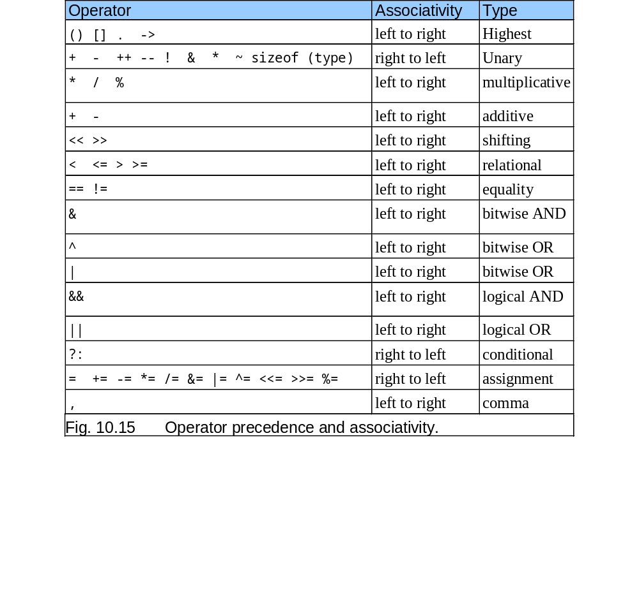
10.9 Bitwise Operators

Slide 39
10.10 Bit Fields
Bit field
  Member of a structure whose size (in bits) has been specified
  Enable better memory utilization
  Must be defined as int or unsigned
  Cannot access individual bits
Defining bit fields
  Follow unsigned or int member with a colon (:) and an integer constant representing the width of the field
  Example:
      struct BitCard {
      unsigned face : 4;
      unsigned suit : 2;
      unsigned color : 1;
      };

Slide 40
10.10 Bit Fields
Unnamed bit field
  Field used as padding in the structure
  Nothing may be stored in the bits
      struct Example {
      unsigned a : 13;
      unsigned : 3;
      unsigned b : 4;
      }
  Unnamed bit field with zero width aligns next bit field to a new storage unit boundary

Slide 41
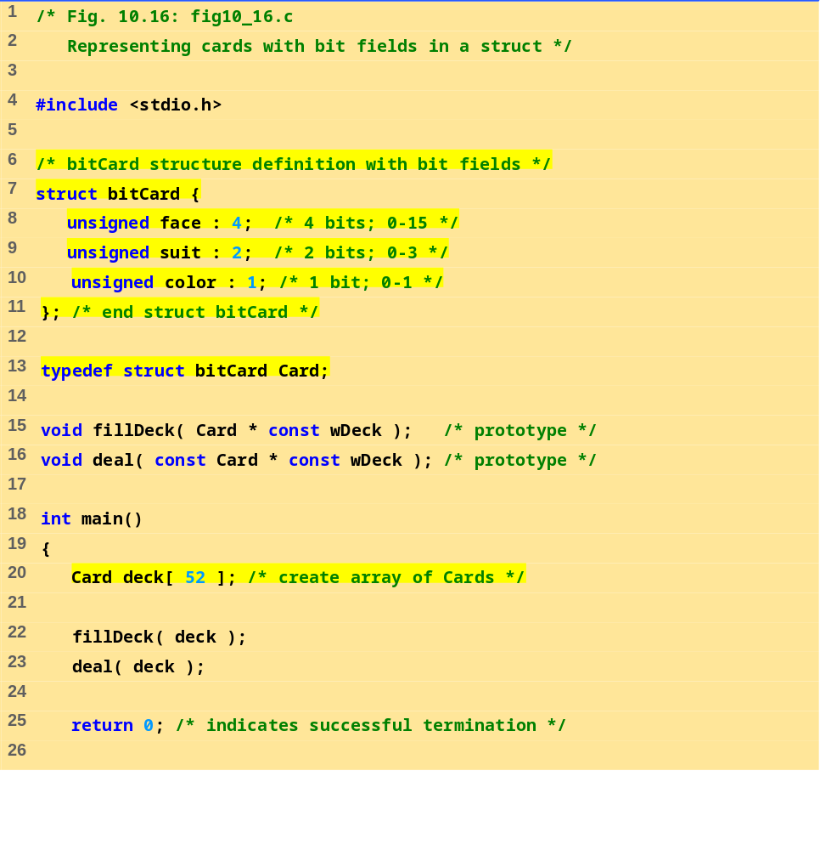
fig10_16.c (1 of 3)

Slide 42
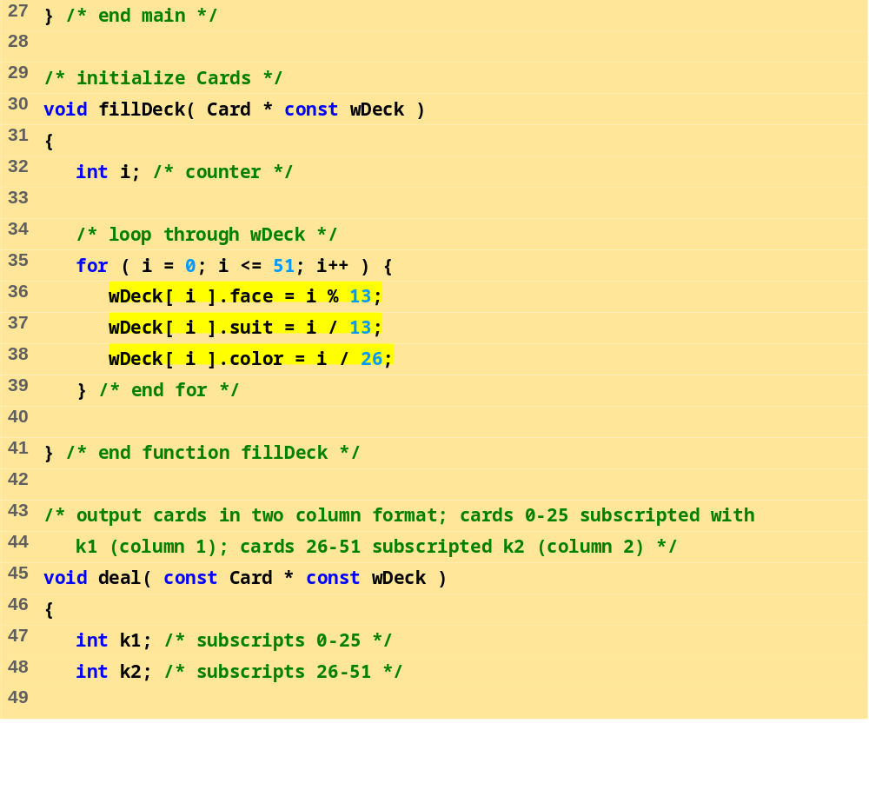
fig10_16.c (2 of 3)

Slide 43
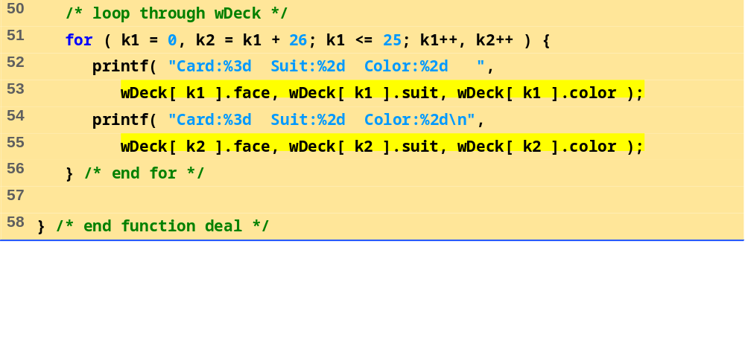
fig10_16.c (3 of 3)

Slide 44
Card: 0 Suit: 0 Color: 0 Card: 0 Suit: 2 Color: 1
Card: 1 Suit: 0 Color: 0 Card: 1 Suit: 2 Color: 1
Card: 2 Suit: 0 Color: 0 Card: 2 Suit: 2 Color: 1
Card: 3 Suit: 0 Color: 0 Card: 3 Suit: 2 Color: 1
Card: 4 Suit: 0 Color: 0 Card: 4 Suit: 2 Color: 1
Card: 5 Suit: 0 Color: 0 Card: 5 Suit: 2 Color: 1
Card: 6 Suit: 0 Color: 0 Card: 6 Suit: 2 Color: 1
Card: 7 Suit: 0 Color: 0 Card: 7 Suit: 2 Color: 1
Card: 8 Suit: 0 Color: 0 Card: 8 Suit: 2 Color: 1
Card: 9 Suit: 0 Color: 0 Card: 9 Suit: 2 Color: 1
Card: 10 Suit: 0 Color: 0 Card: 10 Suit: 2 Color: 1
Card: 11 Suit: 0 Color: 0 Card: 11 Suit: 2 Color: 1
Card: 12 Suit: 0 Color: 0 Card: 12 Suit: 2 Color: 1
Card: 0 Suit: 1 Color: 0 Card: 0 Suit: 3 Color: 1
Card: 1 Suit: 1 Color: 0 Card: 1 Suit: 3 Color: 1
Card: 2 Suit: 1 Color: 0 Card: 2 Suit: 3 Color: 1
Card: 3 Suit: 1 Color: 0 Card: 3 Suit: 3 Color: 1
Card: 4 Suit: 1 Color: 0 Card: 4 Suit: 3 Color: 1
Card: 5 Suit: 1 Color: 0 Card: 5 Suit: 3 Color: 1
Card: 6 Suit: 1 Color: 0 Card: 6 Suit: 3 Color: 1
Card: 7 Suit: 1 Color: 0 Card: 7 Suit: 3 Color: 1
Card: 8 Suit: 1 Color: 0 Card: 8 Suit: 3 Color: 1
Card: 9 Suit: 1 Color: 0 Card: 9 Suit: 3 Color: 1
Card: 10 Suit: 1 Color: 0 Card: 10 Suit: 3 Color: 1
Card: 11 Suit: 1 Color: 0 Card: 11 Suit: 3 Color: 1
Card: 12 Suit: 1 Color: 0 Card: 12 Suit: 3 Color: 1
Program Output

Slide 45
10.11 Enumeration Constants
Enumeration
  Set of integer constants represented by identifiers
  Enumeration constants are like symbolic constants whose values are automatically set
    Values start at 0 and are incremented by 1
    Values can be set explicitly with =
    Need unique constant names
  Example:
    enum Months { JAN = 1, FEB, MAR, APR, MAY, JUN, JUL, AUG, SEP, OCT, NOV, DEC};
    Creates a new type enum Months in which the identifiers are set to the integers 1 to 12
  Enumeration variables can only assume their enumeration constant values (not the integer representations)

Slide 46
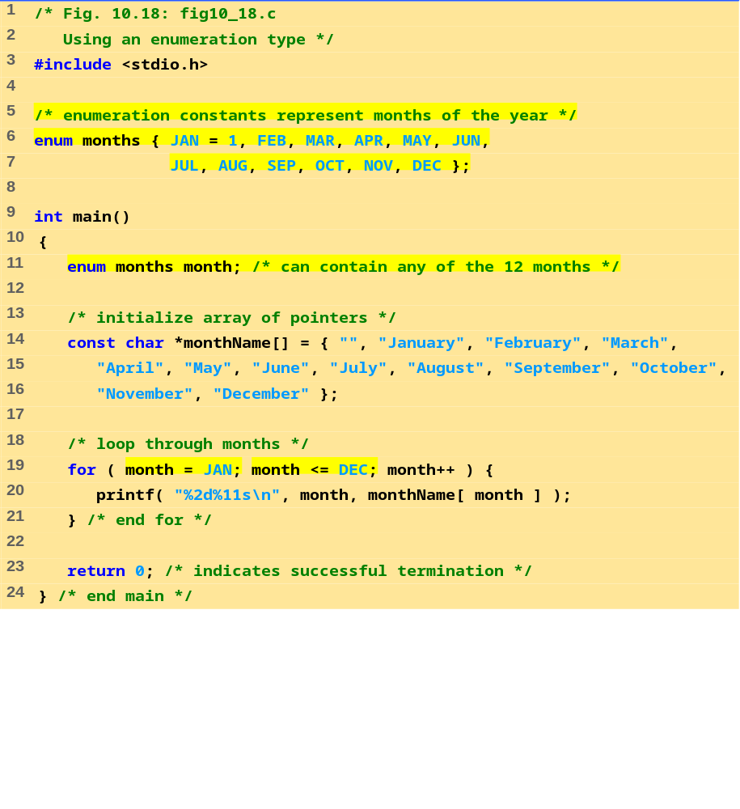
fig10_18.c

Slide 47
1 January
2 February
3 March
4 April
5 May
6 June
7 July
8 August
9 September
10 October
11 November
12 December
Program Output

